Slide 1
Non-Functional Testing
Difference between functional and non-functional
Testing Process
Non-functional Testing Types
Performance testing
Compatibility Testing
Usability Testing
Volume Testing
Security Testing

Slide 2
Difference between functional and non-functional
Functional Testing:
-functional testing demonstrate WHAT the product does
Example: Are you able to login to a system after entering correct credentials
Non-Functional Testing:
-Non-functional testing demonstrate HOW WELL the product behaves
Example: Application load time should not be more than 5 secs up to 1000 users accessing it simultaneously

Slide 3
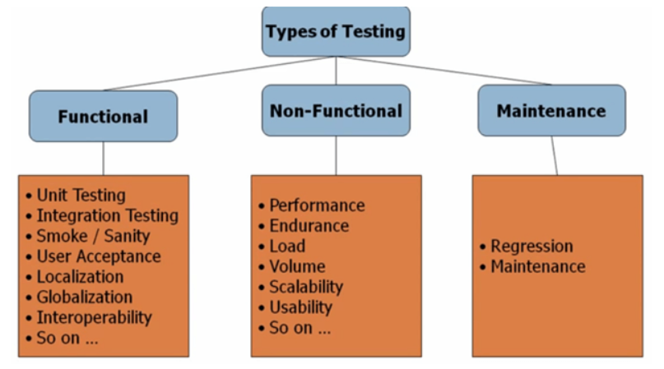
Types of Testing

Slide 4
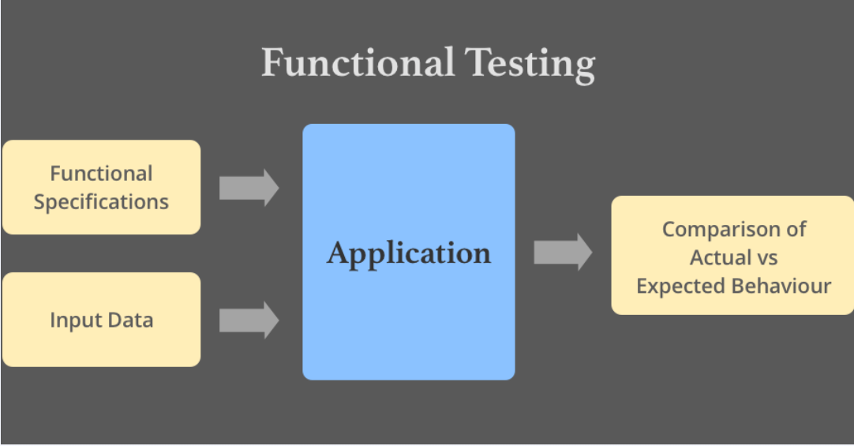
Functional Testing

Slide 5
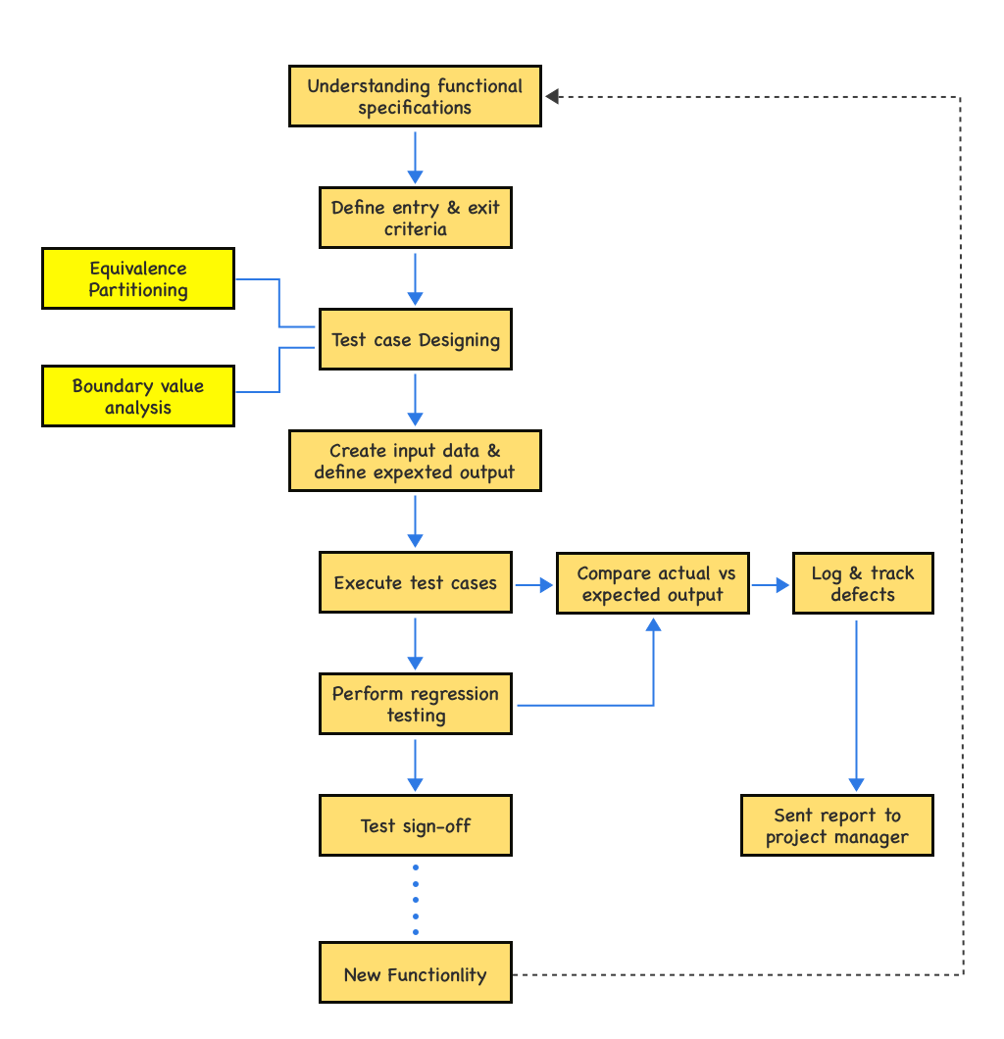
Testing Process

Slide 6

Non-functional Testing Types
Performance Testing
Compatibility Testing
Usability Testing
Volume Testing
Security Testing

Slide 7
Performance testing
Load testing
Load testing is one of the simplest forms of performance testing and is usually conducted to understand the behavior of the system under a specific expected load, for example, the amount of concurrent users on the application performing a specific number of functions within a set duration.
Stress testing
As mentioned above, we normally use stress testing to understand the system’s limits and at which point these are exceeded. Stress testing is especially helpful in determining whether the system will perform in a satisfactory manner if the current load goes well above the expected maximum.

Slide 8
Performance testing
Endurance testing
Endurance testing, occasionally also called ‘soak testing’ essentially involves putting a significant load onto the system for an extended period, the goal being to discover how the system behaves under sustained use.
Spike testing
Spike testing is aimed at determining whether system performance will suffer by sudden and dramatic changes in load. This is often carried out by suddenly increasing the number of users or the load generated by them and observing the system’s behavior.
Configuration testing
Configuration tests are not concern with the load on the system as such, and rather aim to determine the effects on the system’s performance brought about by any configuration changes to the system’s components.

Slide 9
Compatibility Testing
Browser Compatibility Testing
With Cross Browser Testing, you can ensure that your website renders and performs correctly on iPhones, Androids, and many more. You also will be able to debug your website on a specific real device allowing you to identify any one-off bugs.
Hardware
It is to check the application/ software compatibility with the different hardware configurations.
Network
It is to check the application in a different network like 3G, WIFI, etc.
Operating Systems
It is to check if the application is compatible with different Operating Systems like Windows, Linux, Mac, etc.
Hardware
It is to check the application/ software compatibility with the different hardware configurations.
Network
It is to check the application in a different network like 3G, WIFI, etc.
Versions
It is important to test software applications in different versions of the software. There are two different types of version inspection.

Slide 10
Usability Testing
Definition:
Usability Testing is an attempt to evaluate a product’s usability. In most cases, the best way to do this is by having users test your product while observing their behavior as they do so.
Example:
For example, if you are designing a website for a supermarket, and that website allows users to do their groceries online, the best way of testing your design is by having a user proceed through your product as you watch them trying to buy their groceries.
If this works out successfully, the user will probably flow very well through your interfaces and end up achieving their goal. On the other hand, if it wasn’t successful, then most likely they will stumble across multiple, faulty elements and you will be able to observe them being confused, trying to find out what to do next, or even asking questions such as “What do I do now?”
The goal with Usability Testing is to recreate real world scenarios where the user will be using your product, then by observing their behavior you will be able to understand what could be done better.

Slide 11
Volume Testing
S.No | Volume Testing | Load Testing
1 | The volume testing is done to verify the database performance against a large volume of data in the DB. | The load testing is done by changing the user loads for the resources and verifying the performance of the resources.
2 | The primary focus of this testing is on ‘data’. | The primary focus of this testing is on ‘users.
3 | The database is stressed to the maximum limit. | The server is stressed to the maximum limit.
4 | A simple example can be creating a huge sized file. | A simple example can be creating a large number of files.
Definition:
Volume testing is done to analyze the system performance by increasing the volume of data in the database
Example:
For example, testing the music site behavior when there are millions of user to download the song.

Slide 12

Security Testing
SECURITY TESTING is a type of Software Testing that uncovers vulnerabilities, threats, risks in a software application and prevents malicious attacks from intruders. The purpose of Security Tests is to identify all possible loopholes and weaknesses of the software system which might result in a loss of information, revenue, repute at the hands of the employees or outsiders of the Organization.
Example Test Scenarios for Security Testing:
A password should be in encrypted format
Application or System should not allow invalid users
Check cookies and session time for application
For financial sites, the Browser back button should not work.

